Slide 1
Racing Game Using Motion Controls
Marcellus Parley

Slide 2
Motivation
Games are fun.
Learning experience.
Learning is fun.
I think touch controls in mobile games are unintuitive/obnoxious to use.

Slide 3
Proposal
To develop an Android racing game that uses the accelerometer or gyroscope as its steering mechanism/main controlling device.

Slide 4
Features
Controlled primarily using motion sensors rather than touch controls.
AI controlled opponents.
Multiplayer?
Varied levels with multiple varied obstacles.
Built in some framework that would make development easier. (Maybe Godot?)
Track best times, points, outcomes.

Slide 5
Phone Requirements
Accelerometer
Depending on assets used/design may require beefier hardware.

Slide 6
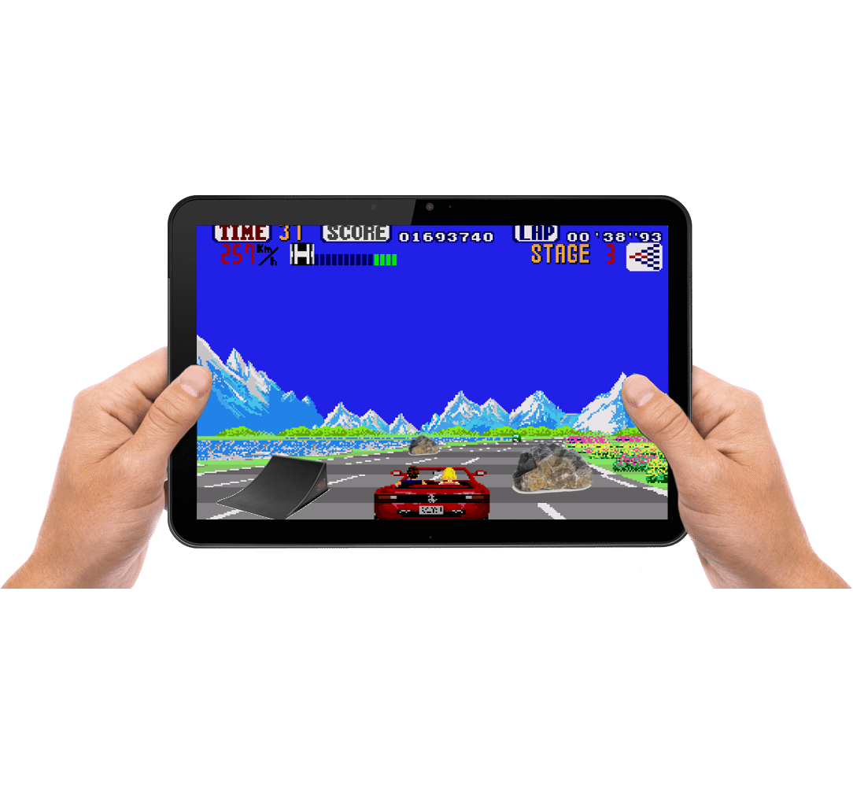
Mockups
Maybe think Outrun or Hang-On (but probably more like Mach Rider)

Slide 7
Project Timeline
~1.5-2 Weeks: For researching tools/process/design
~1.5-3 Months (or maybe probably more): For working prototype, with placeholder assets but basic working controls not and basic design frame in place
A really long time that I have no clue about: For finished game that is fun and interesting to play.

Slide 8
Deliverables
Realistically, if anything, a game where you can move left and right on a track that disappears over the horizon with things zooming at and past your vehicle to give the illusion of motion.
Even more realistically, nothing because I have no idea what I’m doing or where to start. But I am really very sleepy.

